Slide 1
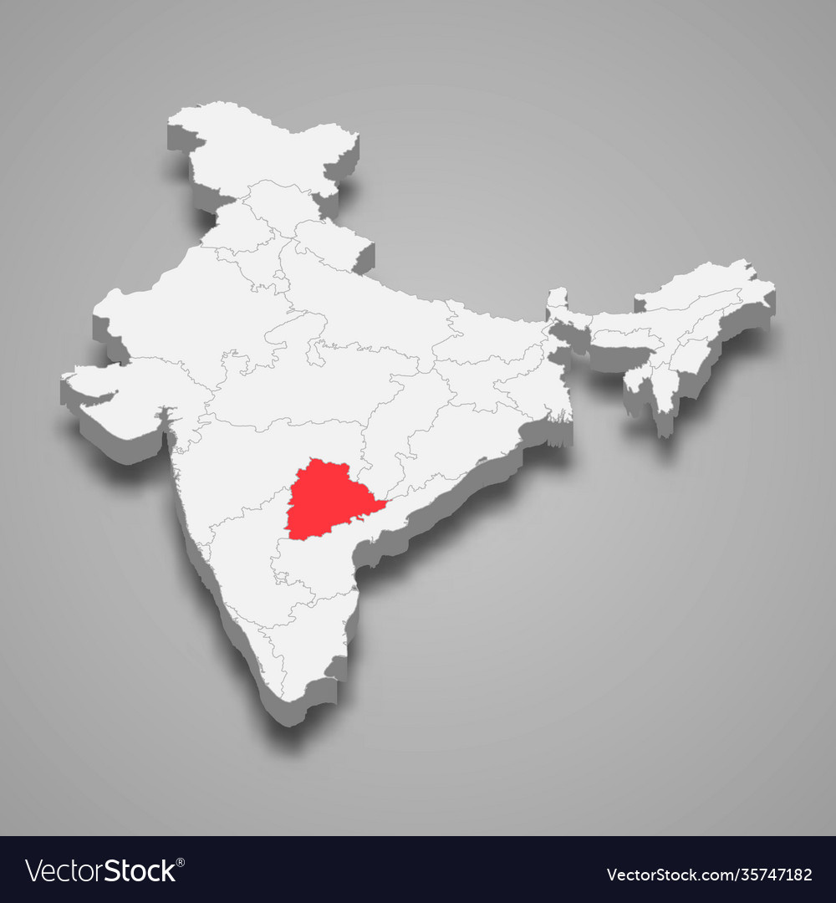


TELANGANA
GROWTH ANALYSIS
Presented by:
Burhanuddin Khokhawala

Slide 2
Overview
Recomm
endations
Introduction
Objective
Insights

Slide 3
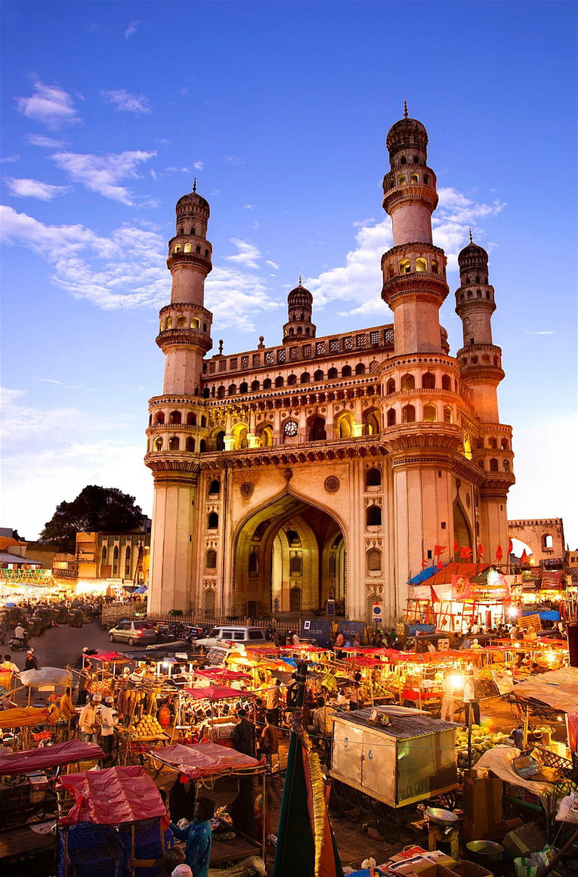
Introduction
Telangana was born on June 2, 2014 it is India’s 29th and youngest state.
Telangana is one of the fastest-growing states in India and one of the states with an open data policy.
The government of Telangana has collaborated with Codebasics to identify growth opportunities.

Slide 4



Objective
The primary objective of this Project is to analyze and gain insights from three main datasets:
Stamps Registrations
Transportation
TS-iPASS

Slide 5
About The Datasets
Stamps
Transportation
TS-iPASS
Documents Registered Count
Documents Registered Revenue
E-stamps Registered Count
E-stamps Registered Revenue
Vehicle sales by fuel-type
Vehicle sales by vehicle class
Vehicle sales by seating capacity
Vehicle sales by other categories
Sectors
Investment in Cr
Employees

Slide 6
INSIGHTS

Slide 7
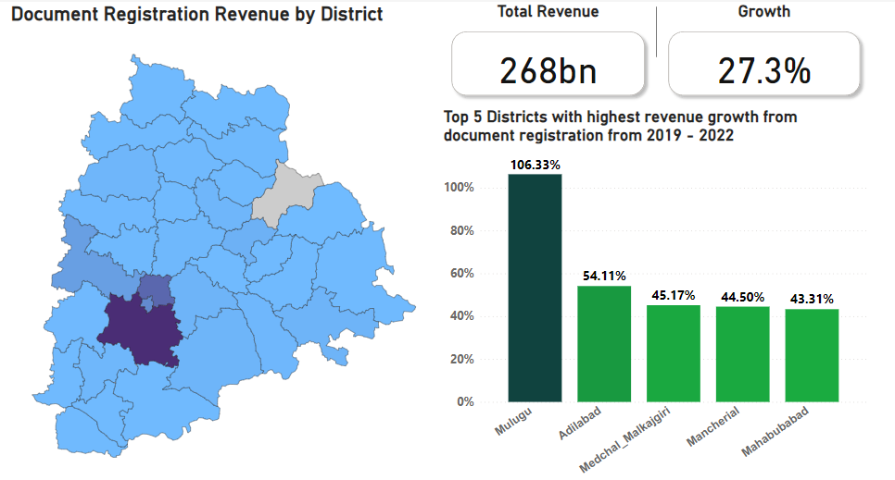
Document Registration Revenue

Slide 8
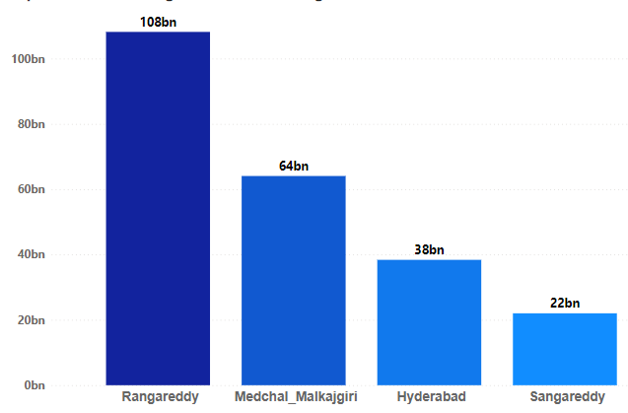
ECONOMIC POWERHOUSES
These are the districts which contribute to 78% of the total Revenue

Slide 9


REASONS
POPULATION
GOVERNMENT OFFICES

Slide 10
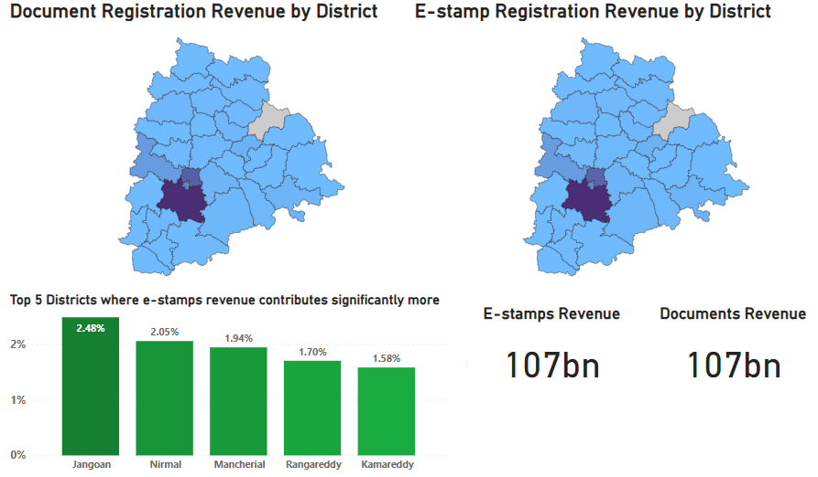
Documents vs E-stamps Distribution

Slide 11
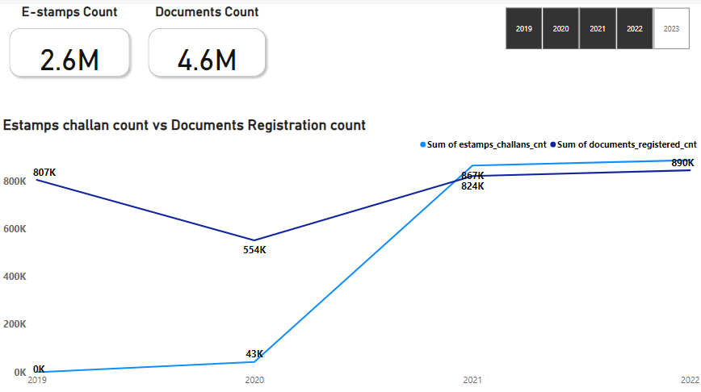
Documents vs E-stamps Trend

Slide 12
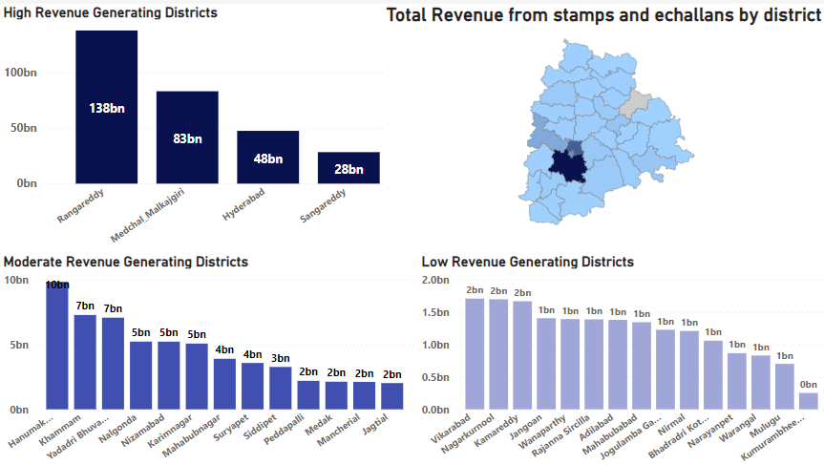
The Three District Categories

Slide 13
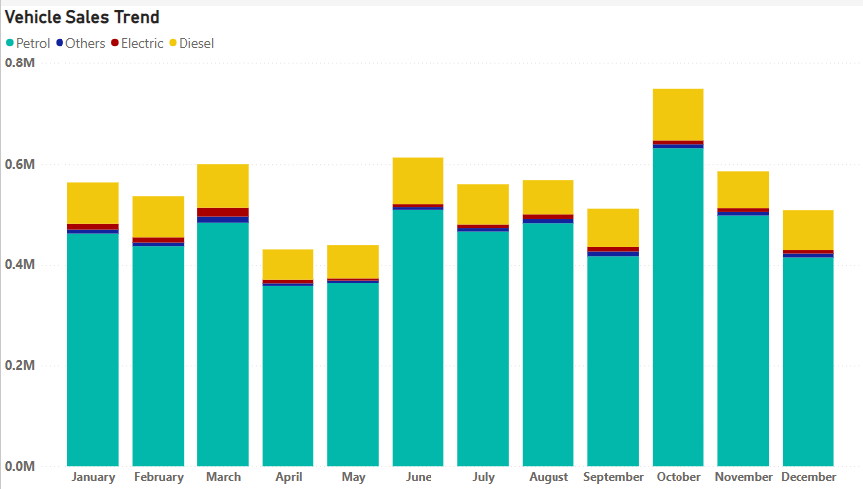
Vehicle Sales Trend

Slide 14
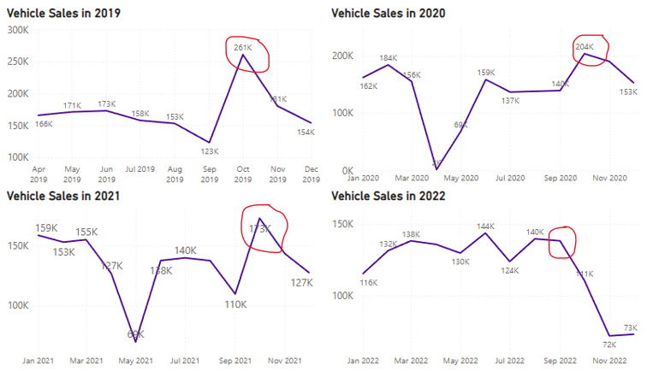
Vehicle Sales Trend

Slide 15



Reasons
Festivals
Bonuses
Discounts

Slide 16
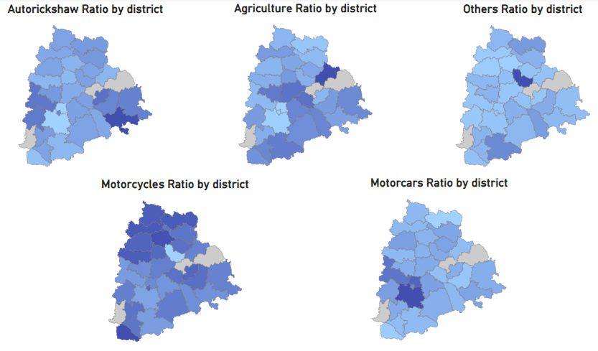
Vehicles Sales Distribution

Slide 17
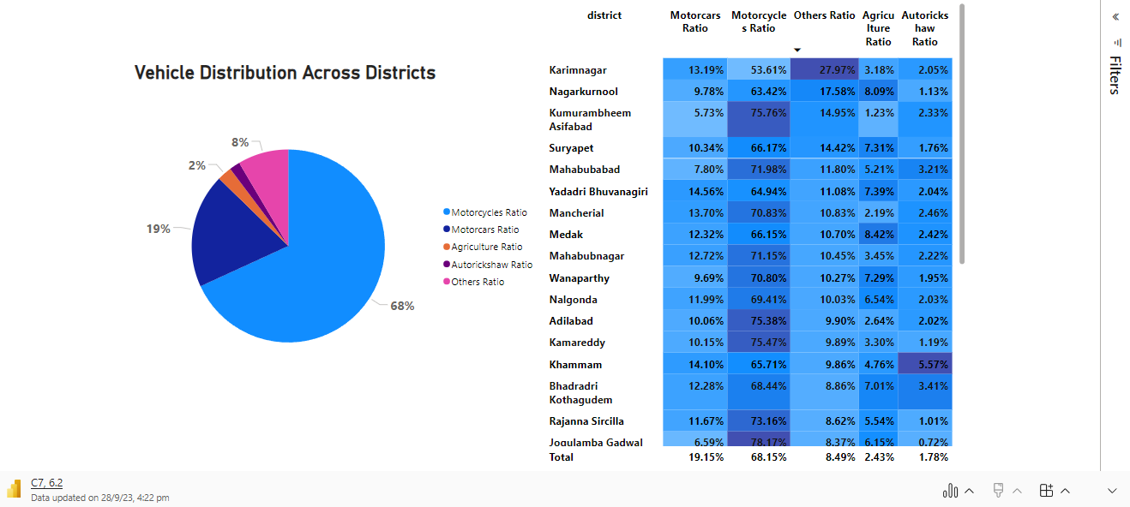
Vehicles Sales Distribution

Slide 18
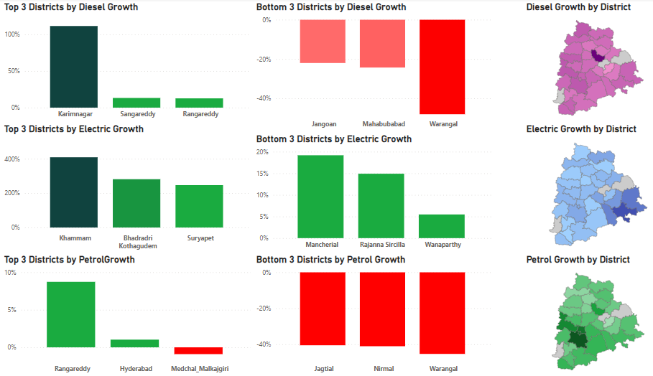
Vehicles Sales Growth

Slide 19
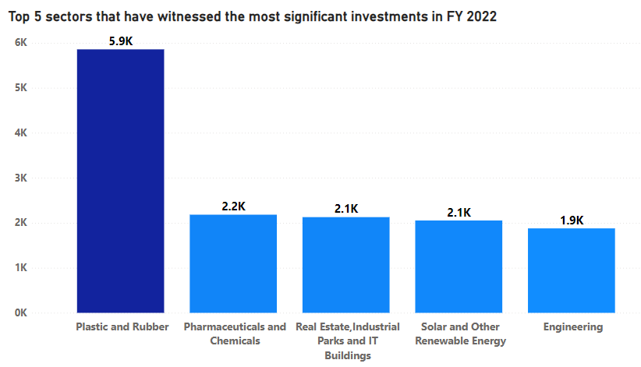
Top 5 Sectors with Most Investment

Slide 20
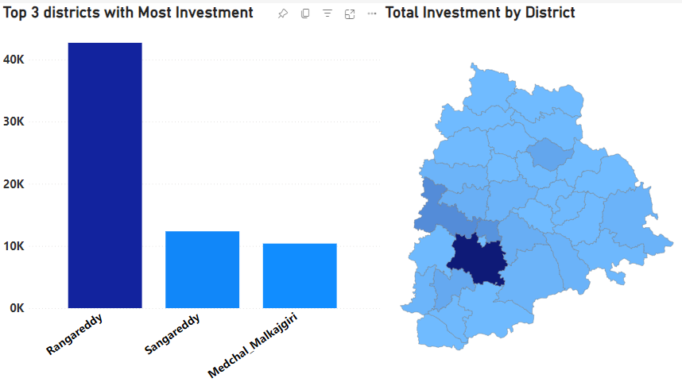



Top 3 Districts with Most Investment

Slide 21
Top 5 districts to buy commercial properties in Telangana
Factors which could have led to the substantial investments in these particular districts

Slide 22
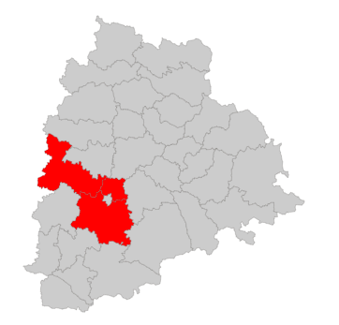

1. Location
These districts are located in the heart of Telangana state
They are well-connected
They are attractive destinations for businesses

Slide 23


2. Infrastructure and Economy

Slide 24
Top 5 districts to buy commercial properties in Telangana
Reasons why Hyderabad has not received substantial Investments

Slide 25

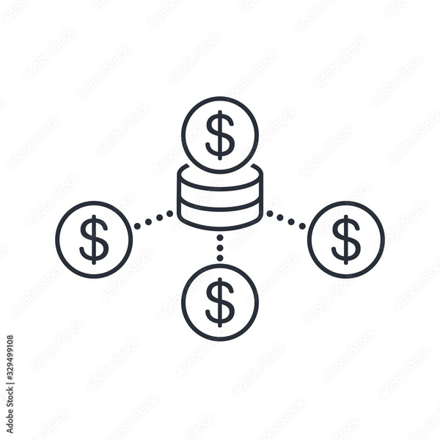

Economic Stability
Strong and stable economy due to its status as a major city and state capital
Economic Diversification
Diversified economic base with thriving industries
Government Focus
Government may be directing investments to other districts

Slide 26
Top 5 districts to buy commercial properties in Telangana
Relationship Between District Investments, Vehicle Sales and Stamps Revenue

Slide 27
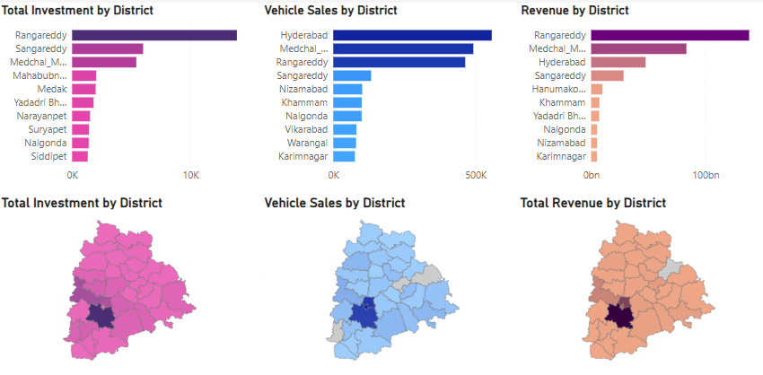

Slide 28
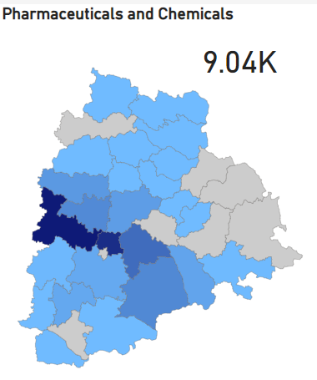
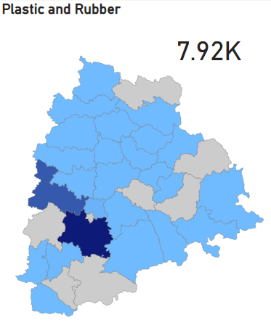
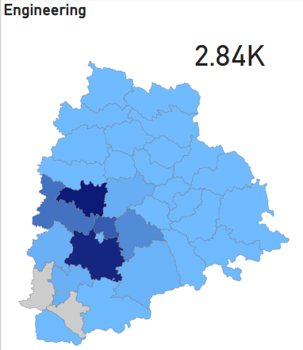
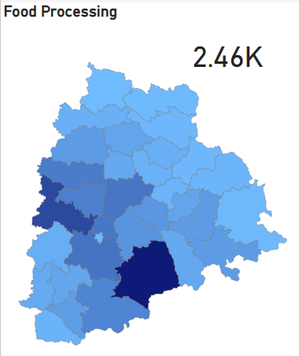
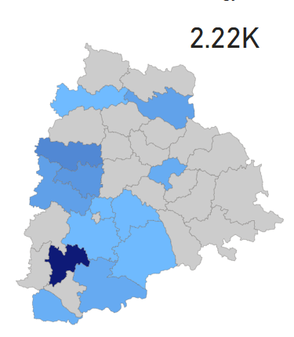
Sectors with Substantial Investments in Multiple Districts
Pharmaceuticals and Chemicals
Plastic and Rubber
Engineering
Food Processing
Solar and other Renewable Energy

Slide 29
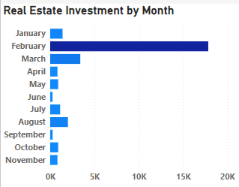
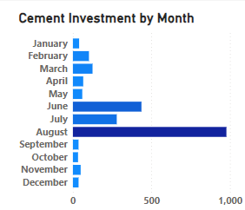
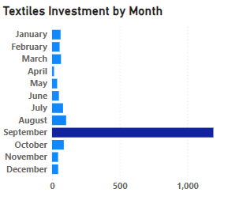
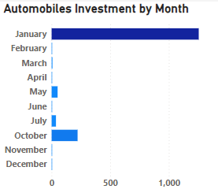
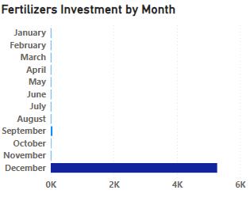
Investment Trend

Slide 30
Top 5 districts to buy commercial properties in Telangana

Slide 31
Hyderabad
Rangareddy
Sangareddy
Commercial Epicenter
Global IT Hub
Diverse Economy
Proximity to Hyderabad
Industrial Zones
Infrastructure
Emerging Industrial Hub
Investment-Friendly Policies
Connectivity
Medchal-Malkajgiri
Yaddadiri-bhuvangiri
Strategic Location
Residential Development
Investment Potential
Proximity to Hyderabad
Industrial and economic growth
Excellent connectivity

Slide 32





Policies and Initiatives
TS-iPASS
Information Technology
and ITES Policy
MISSION KAKATIYA
T-HUB
RYTHU BANDHU SCHEME

Slide 33
Impact
Agriculture's Growing Share: The share of Agriculture and Allied sectors in Telangana's current-price Gross State Value Added (GSVA) has risen from 16.3% in 2014-15 to 18.8% in 2022-23.
Irrigation Investment Impact: The government's substantial investment of Rs 1.61 lakh crore in irrigation projects has led to a significant 117% increase in the Gross Irrigated Area (GIA) in Telangana from 2014-15 to 2022-23.
Tech-Driven Industrial Growth: Innovation and technology are driving industrial growth in Telangana, with 78 incubators and accelerators supporting sectors like Lifesciences, FinTech, Agri Tech, and Digital. Notable startups like "Darwin Box" and "Skyroot Aerospace" have thrived, with T-Hub recognized as the "Best Incubator in India" at the National Startup Awards 2022.
Impressive GSDP Growth: Telangana's Gross State Domestic Product (GSDP) has witnessed substantial growth, with a 155.7% increase in current prices and a 70.7% increase in constant prices from 2014-15 to 2022-23, according to Advance Estimates.

Slide 34
Top 5 Insights

Slide 35
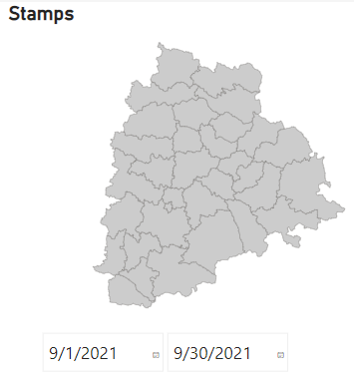
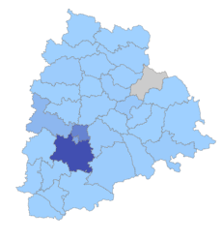
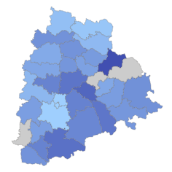
1. Missing Data
There is no information about Jayashankar Bhupalpally in the stamp’s dataset. The stamps dataset also has an entire month’s data missing. There is no data for the month of September in 2021. There is also no information about Mulugu, Narayanpet and Hanumakonda in the transport dataset. Missing data could mean a huge loss for the Telangana Government.

Slide 36
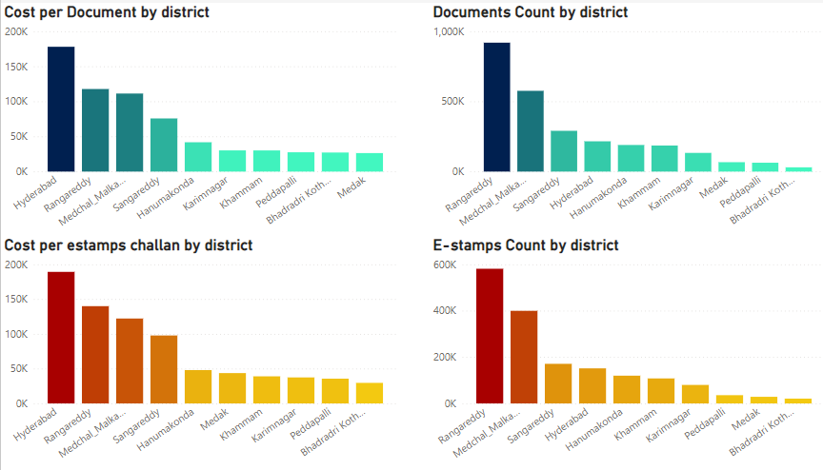
2. Stamp Cost in Hyderabad
Hyderabad generated just Rs 67 billon while districts which had a lower cost per document rate generated much more, Rangareddy generated Rs 189 billion and Medchal-Malkajgiri generated Rs 113 billion

Slide 37
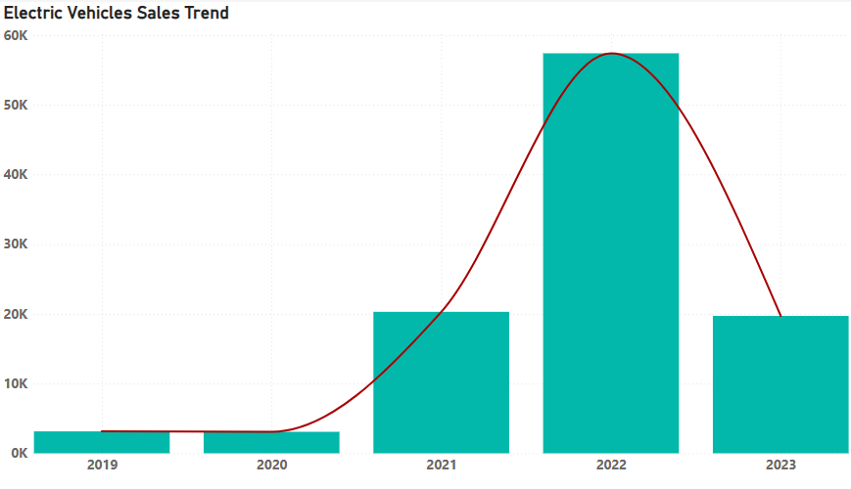
3. Growth in Electric Vehicle Sales
The sales of electric vehicles have a significant growth. In 2021 20k electric vehicles were sold and in 2022 57k electric vehicles were sold. Which is a growth of almost 200%.

Slide 38
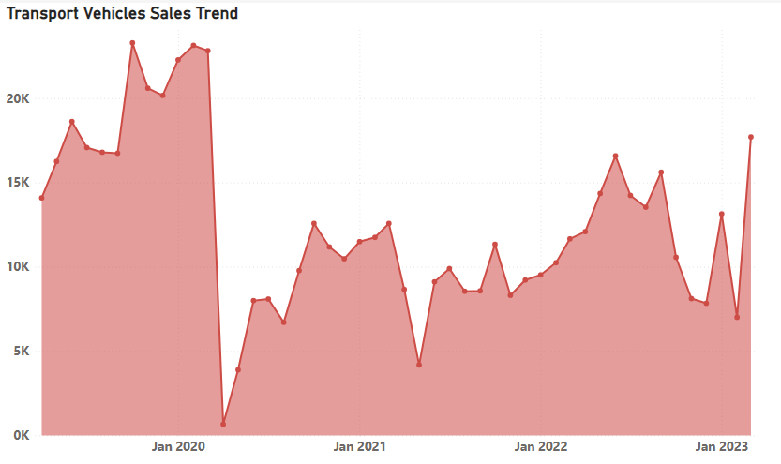
4. Decrease in Sale of Transport Vehicles
The sale of transport vehicles has significantly dropped since lockdown and it has not yet fully recovered. Pre-lockdown sales of transport vehicles were averaged to 19k per month and post lockdown sales are averaging to less than 10k per month. That’s a decrease of 48%.

Slide 39
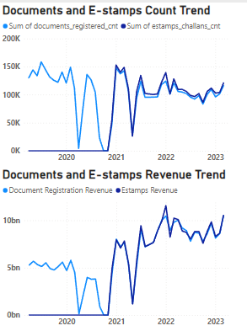
5. Increase in the Cost of Stamps Rate
The count of number of document’s registered has decreased over the years however the revenue has significantly increased. The revenue generated through documents before lockdown was approximately Rs 6 billion per month, at that time e-stamps were not yet introduced. After lockdown the revenue generated through documents and e-stamps is approximately Rs 8 billion each.

Slide 40
INSIGHTS BASED ON
ADDITIONAL RESEARCH

Slide 41

1. GDP Growth
Since its formation, Telangana's economic growth has consistently exceeded the national average. In its first year, the state's GSDP growth was 1 percentage point higher than India's GDP growth. On average, from 2014-15 onwards, Telangana has grown at a rate of 12.5%, surpassing India's average growth rate of 10.5%. Over this period, while India's GDP increased by 118.2%, Telangana's GSDP increased by 155.7%, making it the second-ranked state in terms of overall GSDP growth.

Slide 42

2. High Per Capita Income
Telangana has shown remarkable performance in terms of Per Capita Income (PCI), reflecting a high standard of living. Before its formation, the average Telangana citizen earned Rs. 1,12,162, compared to the average Indian citizen's income of Rs. 79,118. This suggests that the average Telangana citizen earned Rs. 33,044 more than their Indian counterpart.

Slide 43

3. Economic Growth in Telangana's Districts
Rangareddy, Hyderabad and Medchal- Malkajgiri are the most urbanized districts of the state, which account for 43.72% of the state economy at current prices for the year 2021-22. All the districts in the State achieved a positive nominal growth in their Gross District Domestic Product (GDDP). 32 out of the 33 districts achieved double digit growth in their GDDP for the year 2021-22 at current prices.

Slide 44
Recommendations

Slide 45

1.Promote Electric Vehicles
Charging Infrastructure: Invest in the development of a robust and accessible charging infrastructure
Fleet Electrification: Encourage the electrification of government and public transportation fleets

Slide 46

2. Promote E-stamping
Incentives for e-Stamping: Introduce incentives for e-Stamping.
Streamline the e-Stamping Process: Continuously improve and streamline the e-Stamping process

Slide 47
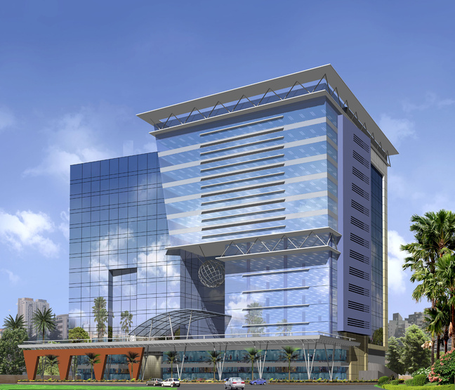
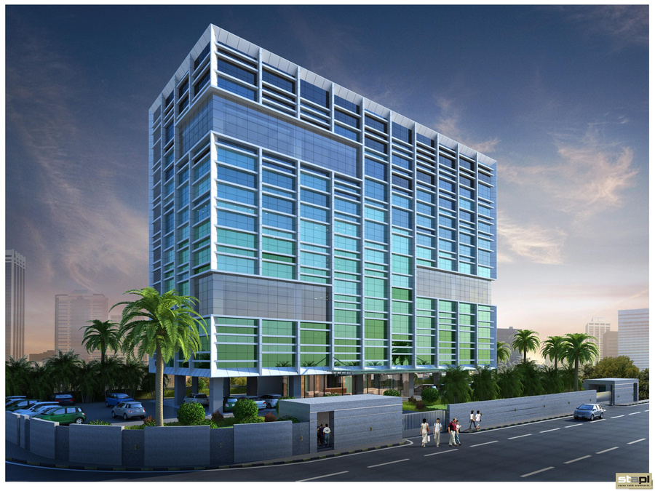
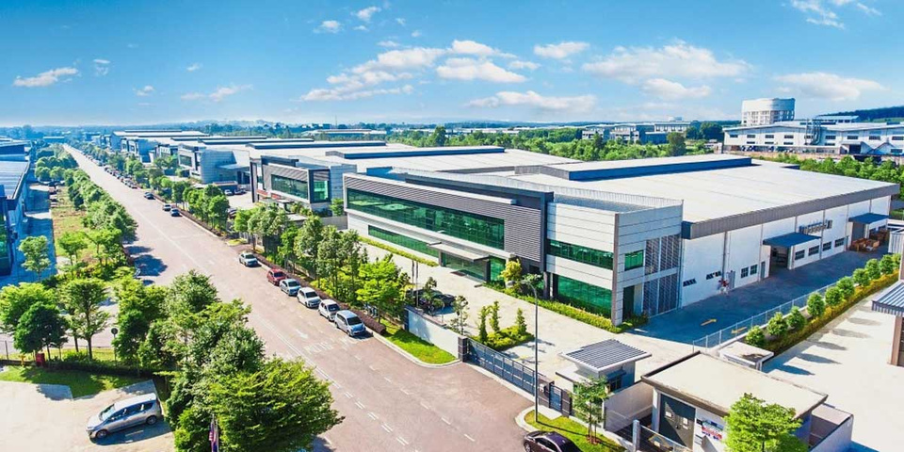
3. Increase the investments in Industrial
Parks and IT Buildings
Economic Growth: Investments in industrial parks can stimulate economic growth by attracting manufacturing companies, industries, and businesses.
Job Creation: Industrial parks and IT buildings are significant sources of employment

Slide 48

4. Invest in Infrastructure Development
in more Districts
Invest in infrastructure projects such as roads, highways, and public transportation systems in the medium and low revenue generating districts. A well-developed infrastructure not only enhances connectivity but also attracts businesses and promotes economic growth.

Slide 49
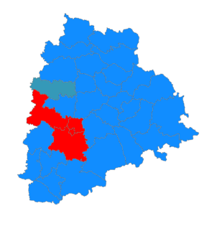
5. Diversify Economic Base
Avoid over-reliance on the powerhouse districts for revenue. Encourage diversification of the economy by promoting sectors like manufacturing, agriculture, healthcare, and tourism in other districts of the state. A diversified economy is more resilient to economic fluctuations. This will help develop the other districts and in turn increase the revenue of the state.

Slide 50

THANK YOU

